Slide 1




Java Server Performance Monitoring

Slide 2

https://youtu.be/D1rlGA_UGrY

Slide 3



Why is my server so slow in production?!

Slide 4

The Usual Suspects
Production versus test system
Amount of data & requests
Hardware setup & infrastructure
Server & database configuration
Network delays

Slide 5
The Usual Suspects
Too many backend calls & SQL queries
(N + One) Issue
JPA/Hibernate Eager & Lazy Loading
Unexpected usage pattern
Pushing beyond the intended limits
Harvesting of your data

Slide 6
The Usual Suspects
Garbage Collection
Hardware bottlenecks
Outdated database statistics
Missing/wrong database index
Sometimes inefficient code

Slide 7

The Road Ahead
Implement performance monitoring
Run performance tests early on
Keep historical performance data

Slide 8


Slide 9

JavaMelody
What requests are processed now?
Collects historical data
CPU, memory, threads
HTTP req/sec & duration, HTTP errors
JDBC connection usage

Slide 10
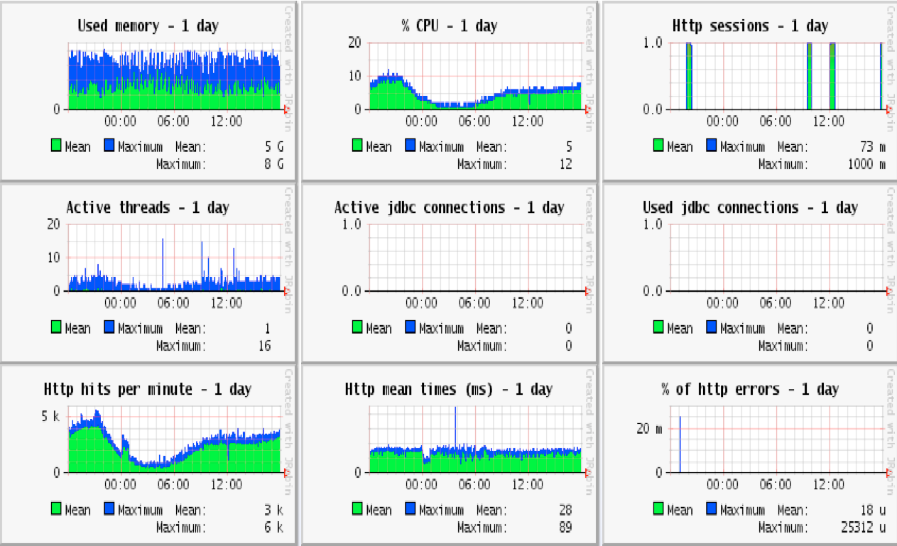

Slide 11
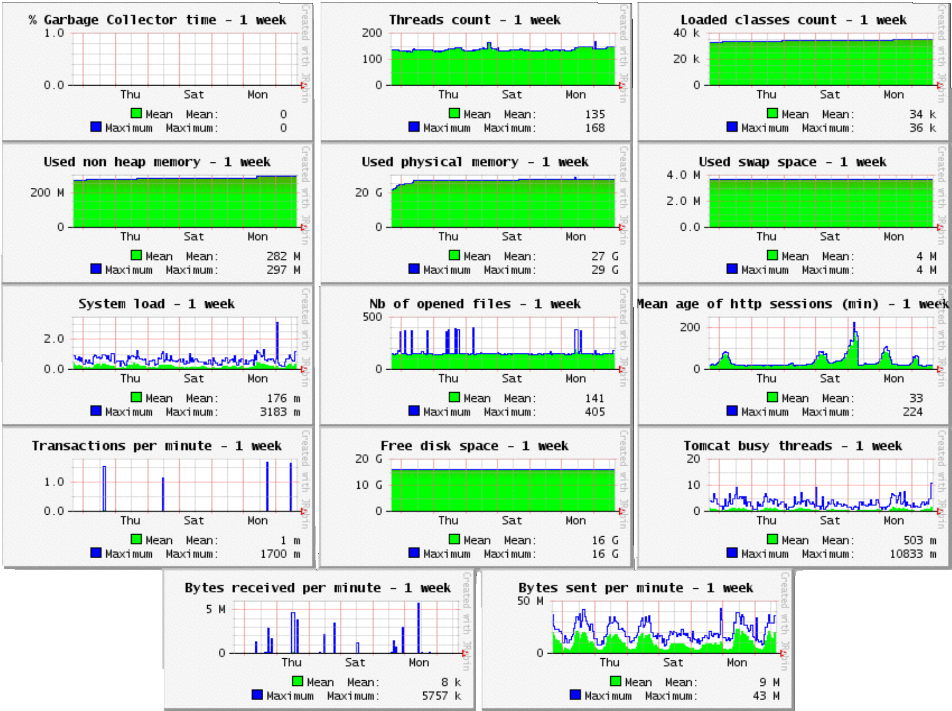

Slide 12
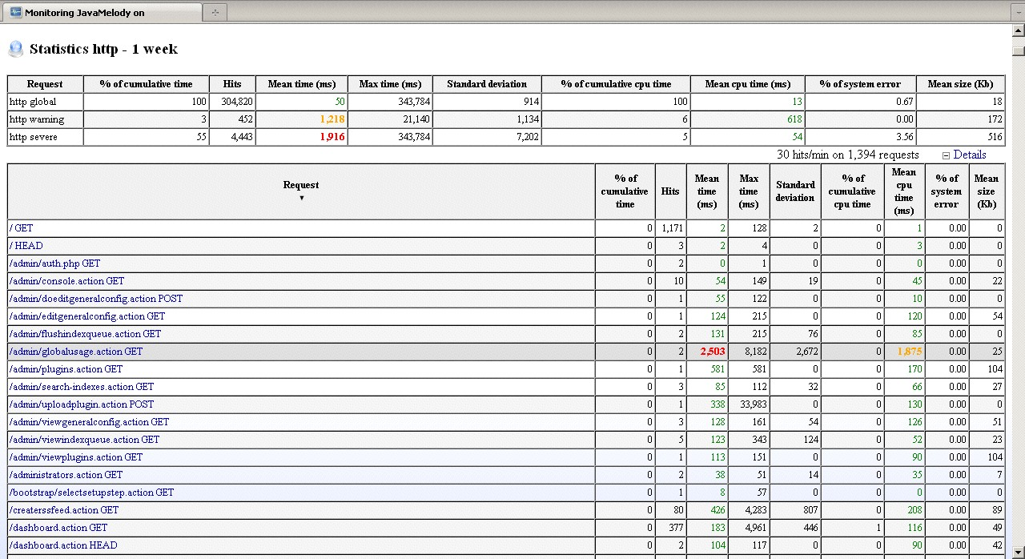

Slide 13

JavaMelody Integration
Requires two libraries
Some tinkering with web.xml
Write access to store historical data

Slide 14
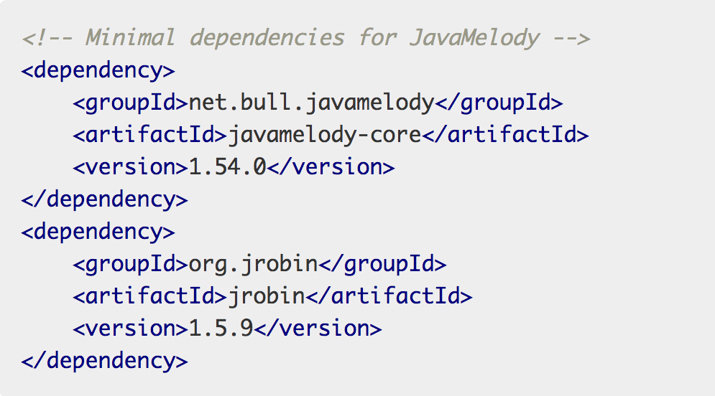

Slide 15
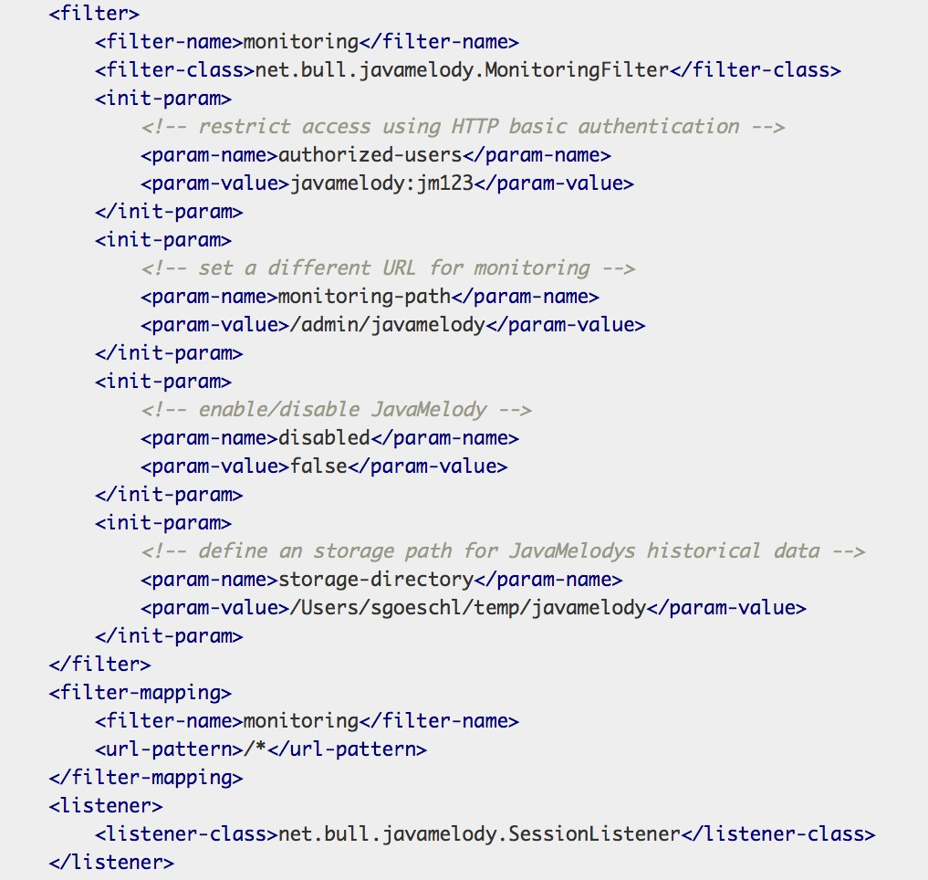

Slide 16

More Integrations
JPA
JDBC
Spring Framework
Enterprise Java Beans

Slide 17


Need more detailed information?!

Slide 18

Code Instrumentation
How often is a method called?
How long does the method to execute?
What methods are executed together?
Real-time access to performance data?

Slide 19
Code Instrumentation
“Around Advice” in AOP speak
AspectJ, Javassist, BCEL
Spring & EJB interceptors
Dynamic Java proxies

Slide 20

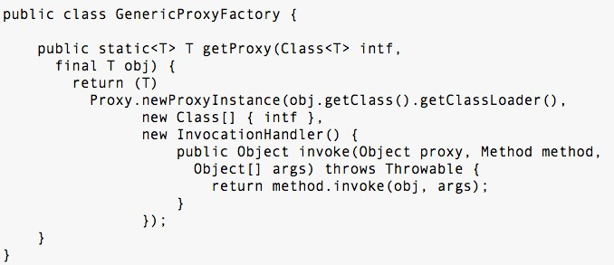
Java Dynamic Proxies
http://www.ibm.com/developerworks/library/j-jtp08305/

Slide 21

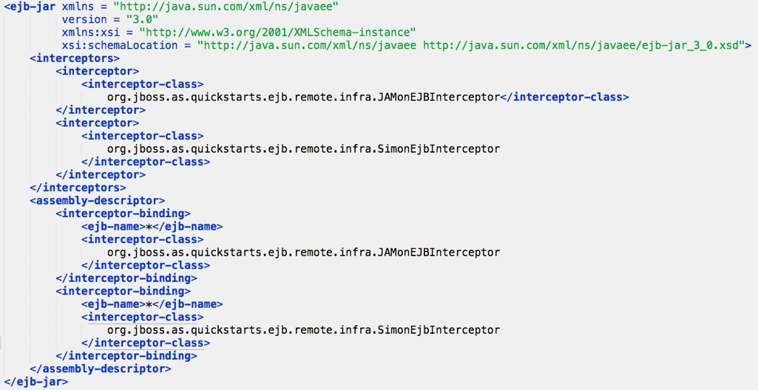
EJB Interceptor

Slide 22

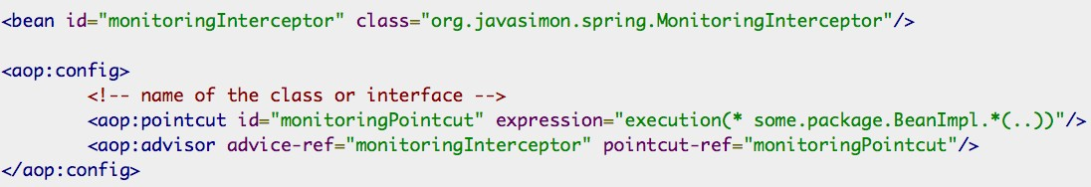
Spring Interceptor

Slide 23
Custom Logging Interceptor
Similar to mySQL slow query log
Intercept instrumented method calls
Execution time determines log level
Can be redirected to a dedicated log file

Slide 24


Slide 25

Introducing JavaSimon
Web GUI can be embedded
Can be exposed as JMX beans
REST API to export JSON, XML, CSV
http://localhost:8080/javasimon-console/ data/tree.xml

Slide 26
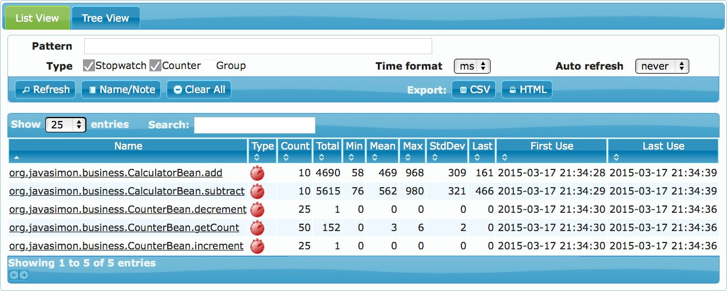

Slide 27
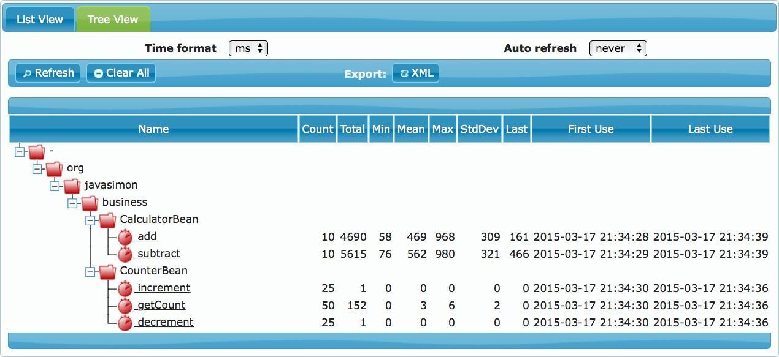

Slide 28
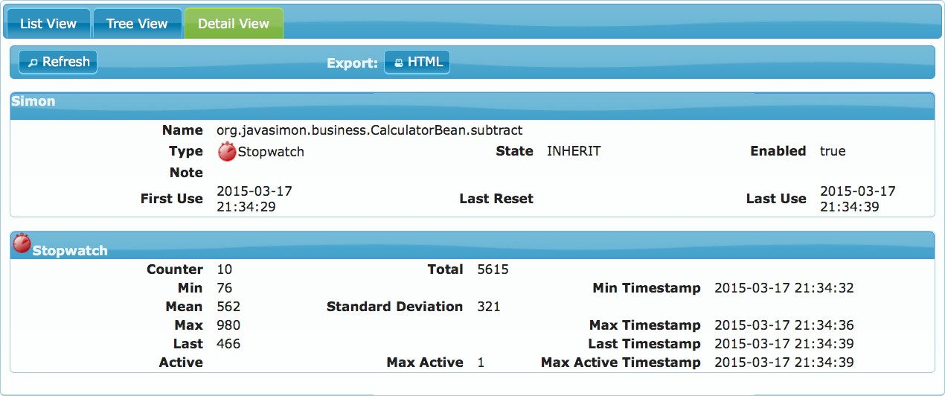

Slide 29

JavaSimon Plugins
Extensible by Web Console Plugins
Quantiles Plugin
Timeline Plugin
CallTree

Slide 30

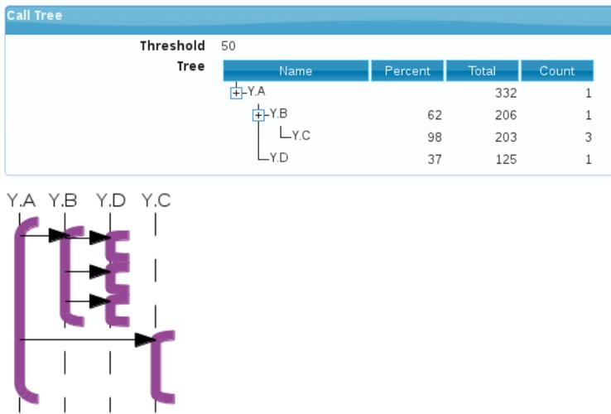
CallTree Plugin

Slide 31



Slide 32

Introducing JavaMon
Web User Interface
Java, HTTP, SQL & Exception monitoring
All monitors can be exposed as JMX Bean
Data can be export as CSV, XML & XLS
Monitoring distributed JAMon installations

Slide 33

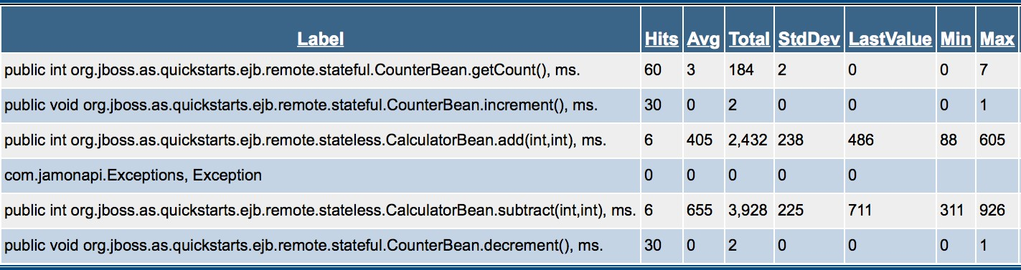
JAMon Admin Page

Slide 34

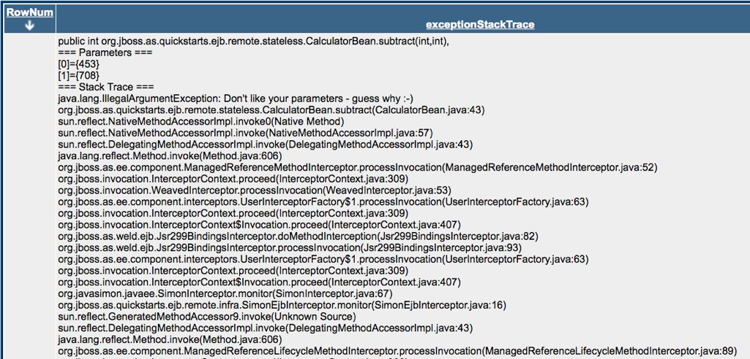
JAMon Exception Page

Slide 35

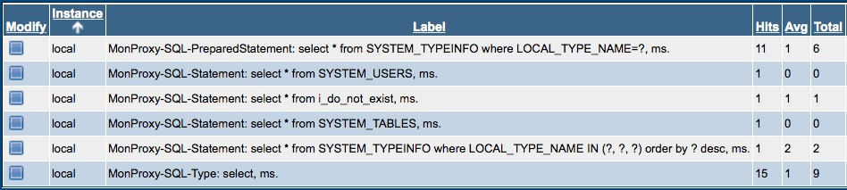
JAMon SQL Monitoring

Slide 36



Other Solutions

Slide 37


Do It Yourself
Custom HTTP Request Monitor
Implemented using servlet filter & JSP
Long-running requests are color-coded
Raspberry Pi collects JSP pages of all server
Displayed on multiple Flat Screen TVs

Slide 38
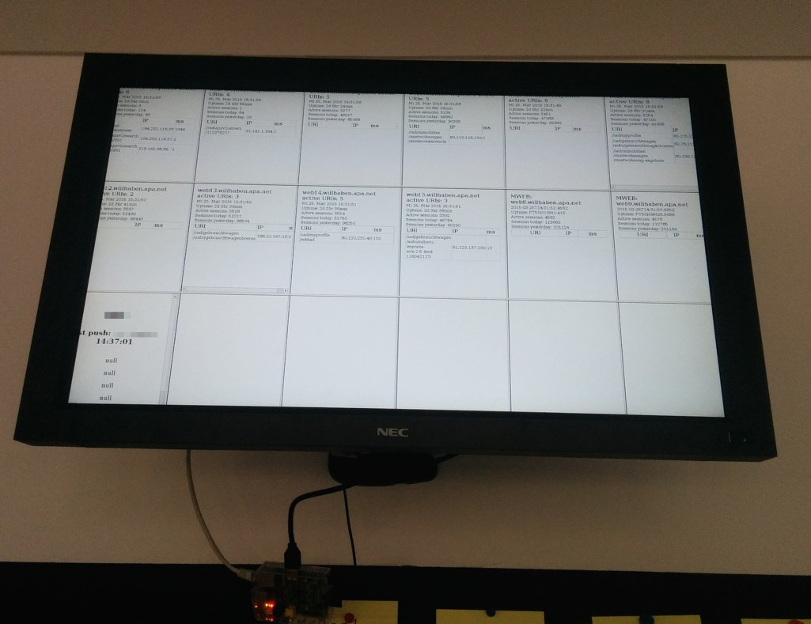

Slide 39
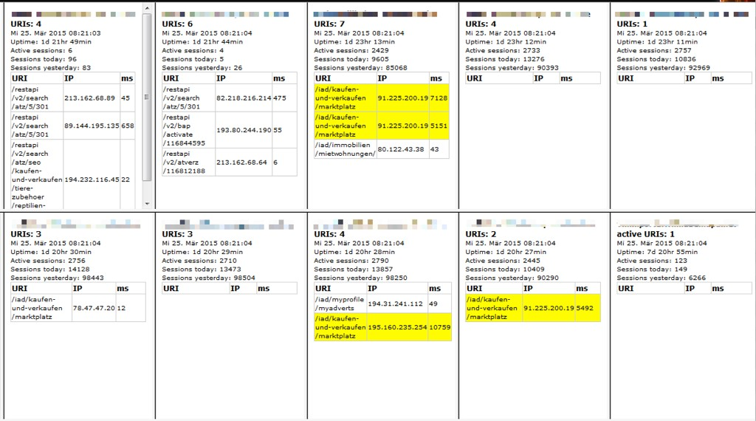

Slide 40

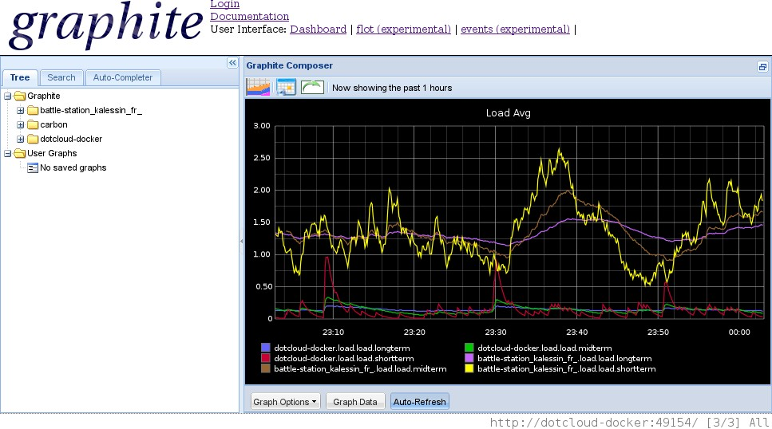
Collectd & Graphite

Slide 41

Apache Sirona
Apache Incubator Project
Java Byte Code Instrumentation
Works for POJOs
Mentioned by Mark Struberg

Slide 42


Things To Take Home

Slide 43

Summary
No excuses to skip monitoring
There are plenty of tools around
Embed your performance monitoring tools
No need to depend on external tools
Be creative to increase visibility

Slide 44


Questions & Answers

Slide 45
JavaMelody
https://code.google.com/p/javamelody/
JavaSimon
https://code.google.com/p/javasimon/
JAMon
http://jamonapi.sourceforge.net
CollectD & Graphite
https://blog.docker.com/2013/07/effortless-monitoring-with- collectd-graphite-and-docker/
Senile Software Engineer’s Blog
http://people.apache.org/~sgoeschl/blog/index.html

Slide 46
